Slide 1


D-ai-ving
Lec-9 Sofmax Classifier
Lec-10 Basic CNN

Slide 2
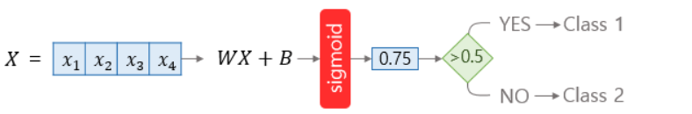
Softmax Classifier
In Logistic Regression

Slide 3
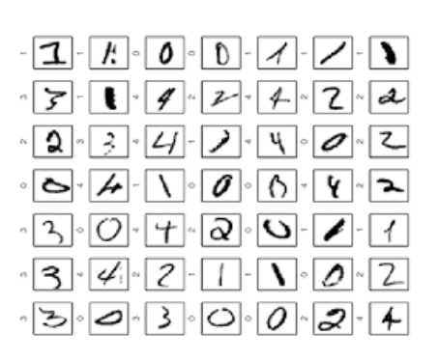
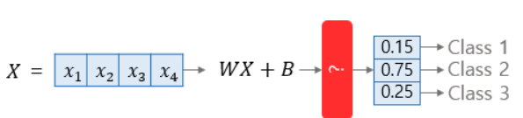
Softmax Classifier

Slide 4
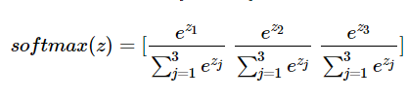
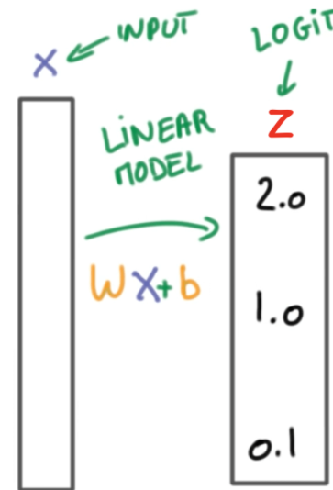
Softmax Classifier
Softmax function

Slide 5
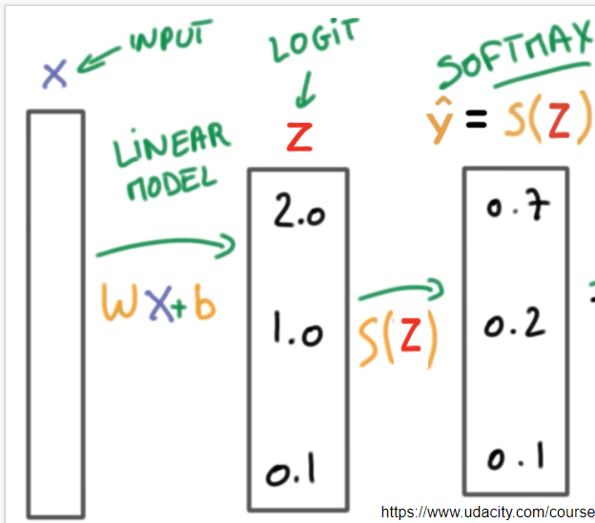
Softmax Classifier
Softmax function

Slide 6
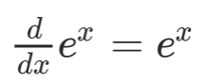
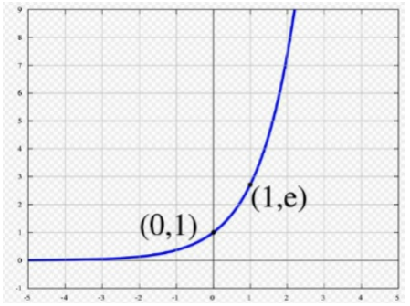
Softmax Classifier
Why ‘e’?
1.
2.
https://www.youtube.com/watch?v=K7HTd_Zgr3w&t=329s

Slide 7
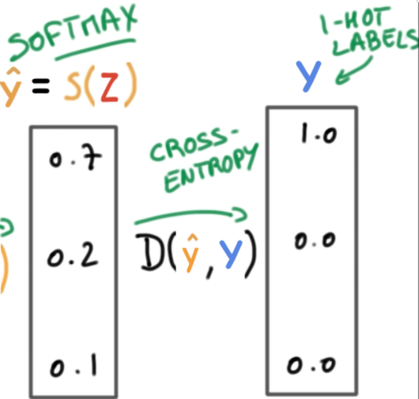
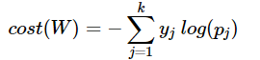
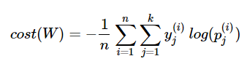
Softmax Classifier
Cost function

Slide 8
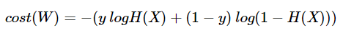
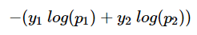
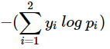
Softmax Classifier
Logistic Regresssion Cost function
y->y1 (1-y)->y2
H(x)->p1 (1-H(x))->p2
Softmax Regresssion Cost function

Slide 9
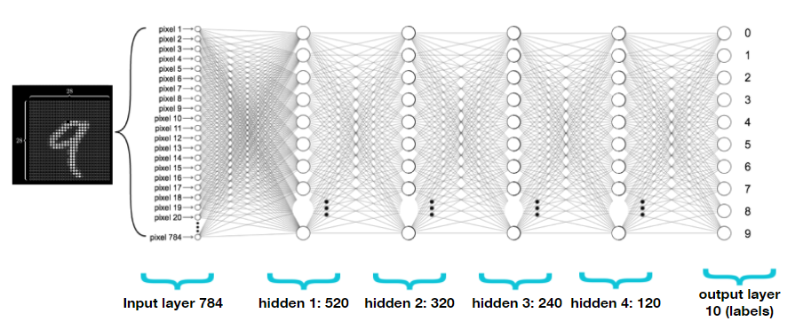
Softmax Classifier

Slide 10
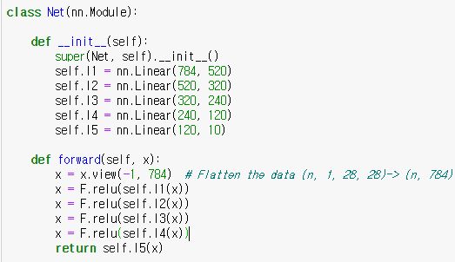
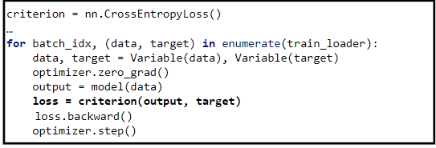
Softmax Classifier

Slide 11
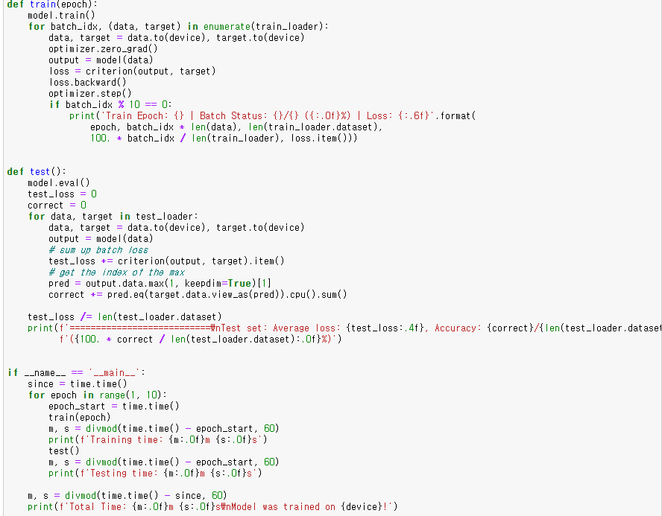
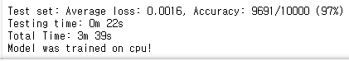
Softmax Classifier

Slide 12
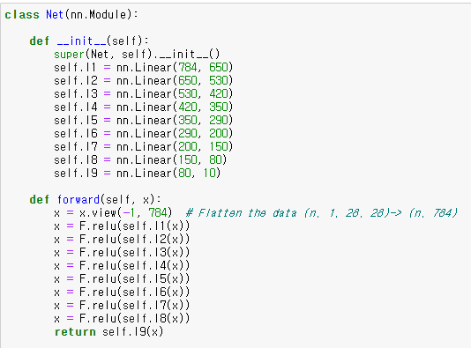
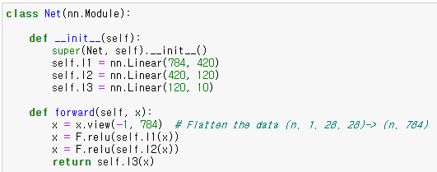
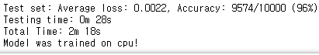
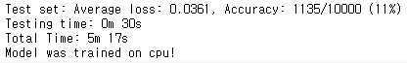
Softmax Classifier

Slide 13
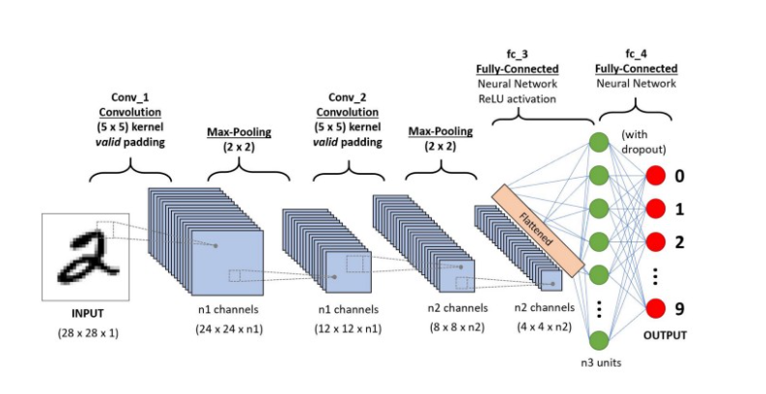
Basic CNN

Slide 14

Basic CNN

Slide 15
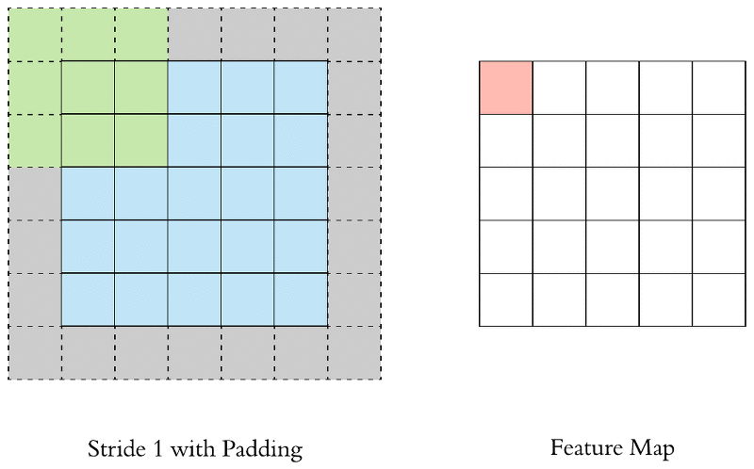
Basic CNN

Slide 16
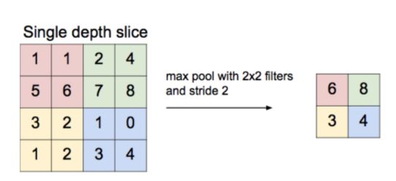
Basic CNN

Slide 17
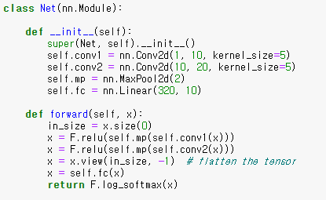
Basic CNN
input:1x28x28
10x24x24
->10x12x12
20x8x8
->20x4x4=320

Slide 18
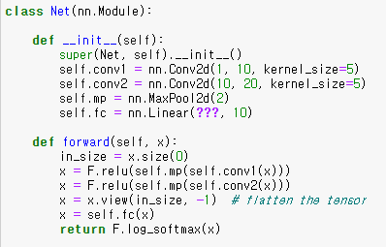
Basic CNN

Slide 19
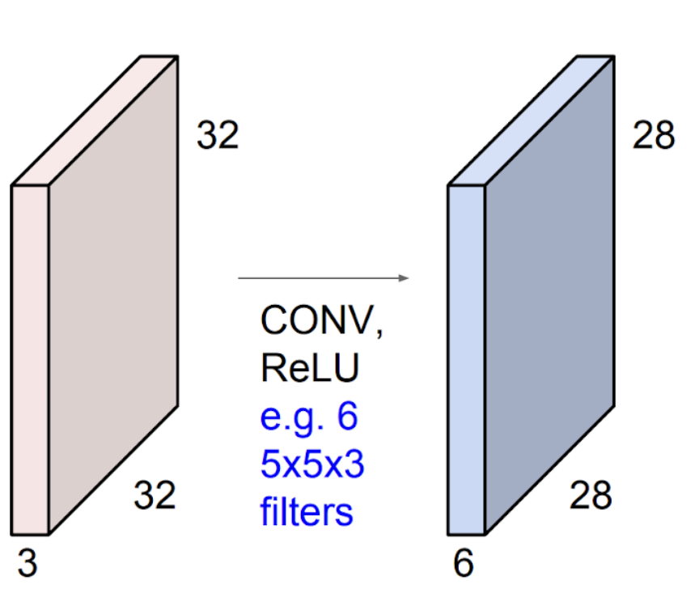
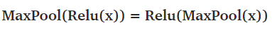
Basic CNN

Slide 20
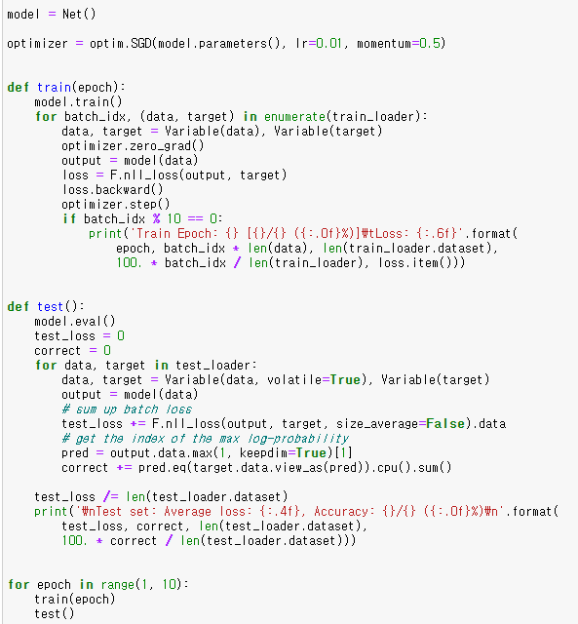
Basic CNN

Slide 21
D-ai-ving
감사합니다!

